Slide 1
Monte Carlo Analysis of Two Sample T test on Movie Data
Dan Agnew, Tyler Hempstead, Mars Alkindi

Slide 2
Project Goal
Perform analysis relevant to stat 400 by using data we had scrapped from IMDB
A question of interest is whether season 2 of tv shows tend to be better or worse than season 1
One way of testing this is with a two-sample t test for difference in population means, however we would be violating the assumption that our two samples are independent
Use Monte Carlo analysis to determine the effectiveness of a two-sample t test for a difference in population means between season 1 and season 2 of tv shows when different assumptions are applied

Slide 3

Data
226 observations of season 1 and season 2 data on TV shows
Data Sampled from top 5000 most voted on TV shows on IMDB

Slide 4
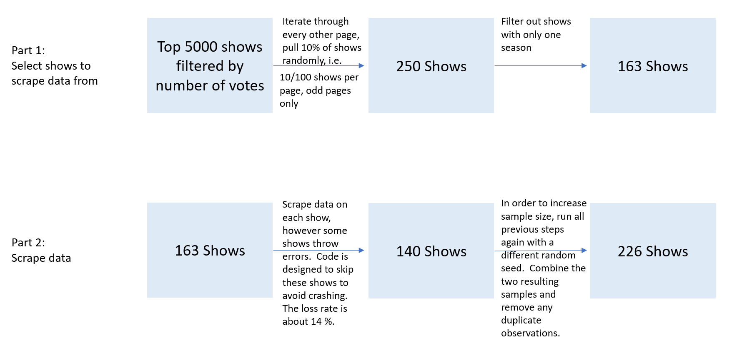

Slide 5
Exploratory Analysis

Slide 6
Background
Suppose we want to test for a difference in population means between season 1 and season 2 ratings. We can try to do this with a two sample T test, however the assumptions will not be properly met:
To run a two sample T test properly here we have to assume that season 1 and season 2 ratings are independent of one another. This is obviously not the case, since people who vote on season 1 will likely also vote on season 2. How much would the results of a two sample T test be harmed by this violation? We aim to answer this using monte carlo simulation.

